Slide 1



















Slide 2
Making your own Website with Github Pages
Introduction to Git, Github, HTML, CSS, JS and ReactJS

Slide 3




What we’ll be covering
Git
ReactJS
(optional)
Github

Slide 4
How would you share files for a project you’re working on with a group of friends?

Slide 5
Why Git?
hello_world.py

Slide 6
Why Git?
hello_world.py
hello_world.py (2)

Slide 7
Why Git?
hello_world.py
hello_world.py (finalFinal2PakkawaalaFinal)

Slide 8

Why Git?
B
hello_world.py
A
C

Slide 9

Works on feature A
Reviews files, approves, comments, makes changes
Works on feature B

Slide 10
Why Git?
Version control
Track files and changes (offline)
Collaborate between with different people
Recall/undo previous changes (offline)

Slide 11
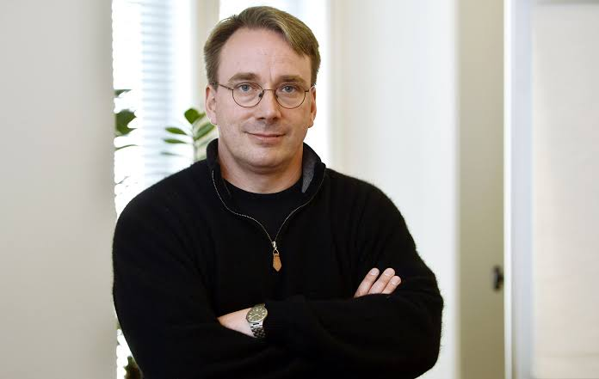
Linus Torvalds
Responsible for Linux among other things

Slide 12

Github $≠$ Git
Github is a online repository hosting service owned by Microsoft which uses git.
Gitlab, Bitbucket are alternatives to Github.
In addition to being a Git hosting service, Github also introduces:
Issue tracking
Projects and feature management tools

Slide 13
Agenda for today
Make a Github account
Modify a few files on a repository
Learn a bit of HTML
Make a draft resume
Use git for managing your resume project

Slide 14
Making your own Website with Github Pages
Day 2
HTML + CSS = nice looking webpages

Slide 15
Outline
What does a good webpage have?
Add some meaningful content on a website
Include
A list
A paragraph
A main header, 2 subsections (based on divs)
Interests
Social media handles (add icons next to them later)
Links to social media handles
An image of your avatar
Use CSS to make it all go cohesively

Slide 16
Outline
Understand proper HTML formatting
Explore new HTML tags
Learn about CSS styling
Position elements using CSS
Customize elements using CSS
Create an avatar
Set up a basic landing page
Notes:
Review tags
HTML format

Slide 17

Final product for today
Create an avatar
Customize h1, p, img
Add links
Add images in line
Organizing & arranging content

Slide 18
General layout of an HTML Document
<html>
<head>
…
<meta>
<title></title>
<script> <style> etc.
…
</head>
<body>
…
<h1></h1>
…
</body>
</html>

Slide 19
Divs
<div>
<h2>
<img>
<p>
</div>
Exists as a block – contains other blocks or inline elements
Inline elements:
<a>, <br>, <img>

Slide 20
Key concepts explored
<div>
<ul>
<style>
How to set fonts
RGB coloring and hex values
CSS stylesheets
Font-size, color, padding
Notes:
Feedbcak -a bit too fast near the end
-flexbox and the others didn’t make much sense
-gotta figure out what the others are doing while some of the class waits
-

Slide 21
Outline
Recap
Background color property
What is each element on the page called
Block vs flex
Show diagram of blocks being arranged, play around with divs
Centre div for projects.html

Slide 22
Making your own Website with Github Pages
Day 4
Understanding Github

Slide 23
Outline for Day 4
What exactly was Github, again?
Branches
Pull, Commit, Push
Adding collaborators
Forking

Slide 24
Why Git?
Version control
Track files and changes (offline)
Collaborate between with different people
Recall/undo previous changes (offline)

Slide 25
Why Git?
hello_world.py

Slide 26
Why Git?
hello_world.py
hello_world.py (2)

Slide 27
Why Git?
hello_world.py
hello_world.py (finalFinal2PakkawaalaFinal)

Slide 28
Why Git?
B
hello_world.py
A
C

Slide 29
Works on feature A
Reviews files, approves, comments, makes changes
Works on feature B

Slide 30
Github $≠$ Git
Github is a online repository hosting service owned by Microsoft which uses git.
Gitlab, Bitbucket are alternatives to Github.
In addition to being a Git hosting service, Github also introduces:
Issue tracking
Projects and feature management tools

Slide 31
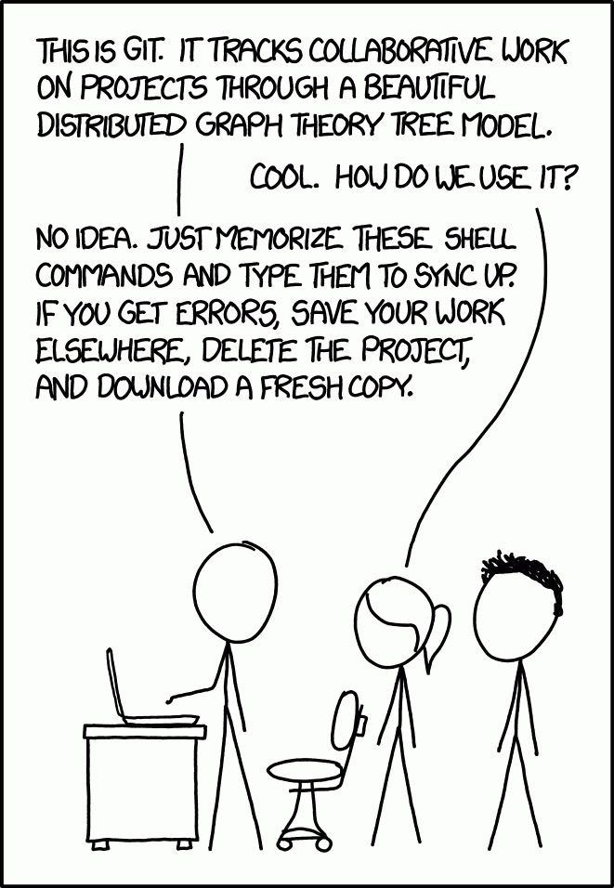

Slide 32
Branches in git
branch
some
commit
some
commit
some
commit
some
commit
Saved changes
Saved changes
Saved changes
Saved changes

Slide 33
Deleting branches in git
branch
some
commit
some
commit
some
commit
some
commit
Saved changes
Saved changes
Saved changes
Saved changes

Slide 34
Deleting branches in git
branch
some
commit
some
commit
some
commit
some
commit
Saved changes
Saved changes
Saved changes
Saved changes

Slide 35
Deleting branches in git
branch
some
commit
some
commit
some
commit
Saved changes
Saved changes
Saved changes

Slide 36
Branches in git
branch
some
commit
some
commit
some
commit
some
commit
Saved changes
Saved changes
Saved changes
Saved changes

Slide 37
Deleting branches in git
branch
some
commit
some
commit
some
commit
some
commit
😢
Saved changes
Saved changes
Saved changes
Saved changes

Slide 38
The main branch
main

Slide 39
Adding a new branch
main
HTML branch
A
B
CSS branch
ا
ب
پ

Slide 40
Pulling and pushing changes
main
HTML branch
Pull
Push
A
B
CSS branch
ا
ب
پ

Slide 41
Pushing changes
branch
some
commit
some
commit
some
commit
some
commit
Saved changes
Saved changes
Saved changes
Saved changes

Slide 42
Pushing changes
some
commit
some
commit
branch
some
commit
some
commit
some
commit
some
commit
Push
Saved changes
Saved changes
Saved changes
Saved changes

Slide 43
Pulling changes
some
commit
Pull
Push
branch
some
commit
Pull
some
commit
some
commit
some
commit
Push
Saved changes
Saved changes
Saved changes
Saved changes

Slide 44
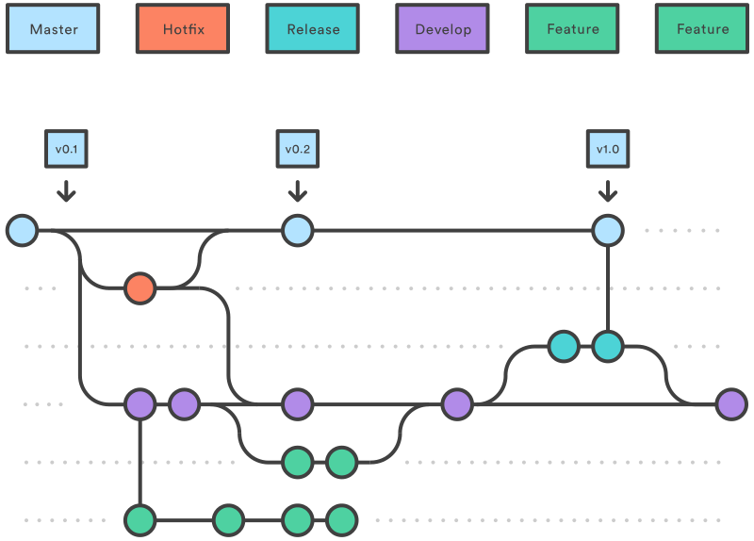
Branching
master/main
other branches

Slide 45
Making your own Website with Github Pages
Day 5
Branching, and some quality of life changes

Slide 46
Outline
VS Code extensions
Live server
Prettier
Separating HTML & CSS files
Branching
Adding a branch
Making changes through a branch
Merging branch

Slide 49
container
content
padding
icons

Slide 50
Outline
Backend-Frontend
What is hosting a website?
Hosting using Github Pages
Narrowing down content for our webpage
[optionally] Taking user input

Slide 51
<a href=https://Instagram.com> Click here! </a>
<a href=https://Instagram.com> <img …> </a>

Slide 52
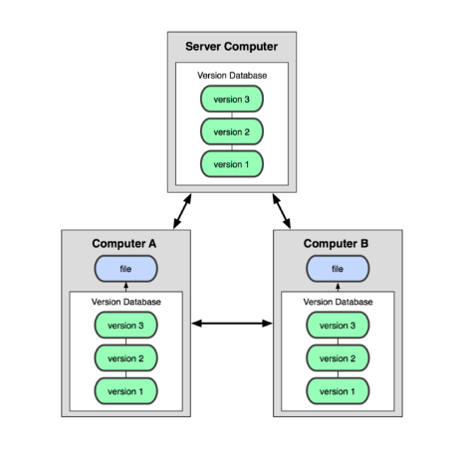
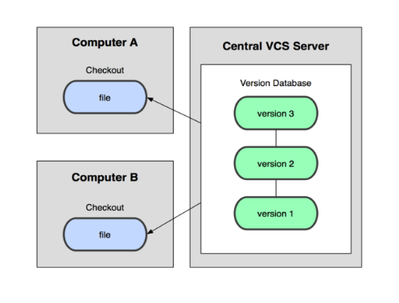
What is Git?
A version control system (VCS).
What is a VCS?
Subversion, Git
Git
Subversion (obsolete)

Slide 53
Github
How to clone a repository
How to create a new repository
Forking repositories
Modifying a notepad file (compare with Word, PowerPoint etc. )

Slide 54
How do devs collaborate?

Slide 55
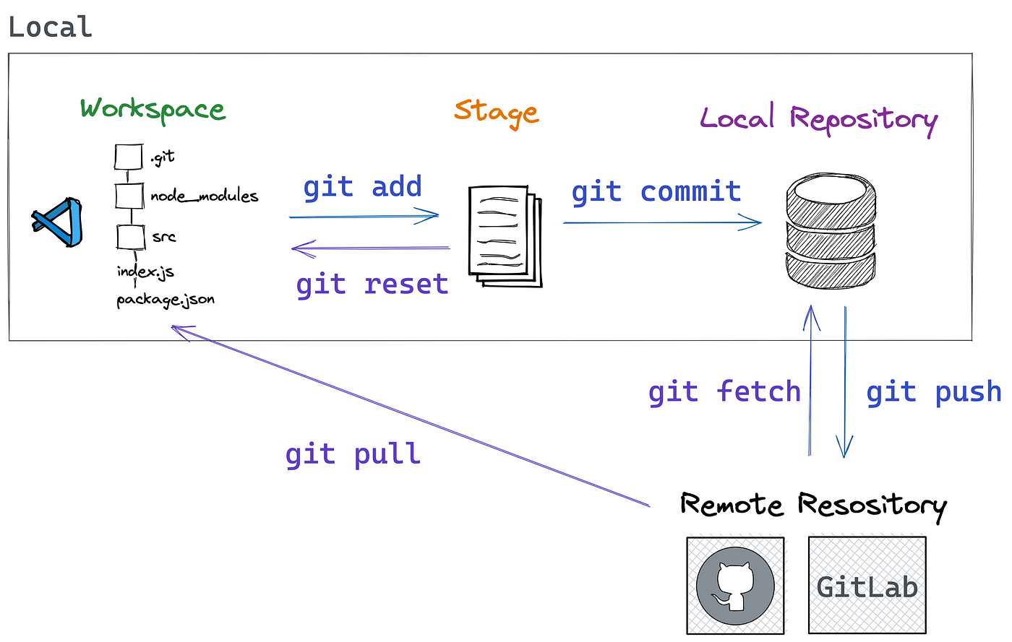

Slide 56
Attributions
Some slides borrowed from slides created by Ruth Anderson for CSE 390a, and CSE403.

